Slide 1


Checkpoint Michael Ames amesam@wfu.edu
Wake Forest
School of Business
_______
11June2020

Slide 2
Where are we at with Python?
Import
Read_csv()
Describe
Describe()
Dtypes()
Columns
Value_counts()
Explore
Crosstabs
Visualize
Histograms
Bar charts
Business Rules
Simple conditional logic
Build Trees
Tree Depth
Min Samples Split
Evaluation
Accuracy
Confusion Matrix
Pipelines
Categorical handling
Missing value handling
Fit, predict, predict_proba

Slide 3
Simple ID3 Decision Trees
Pseudo Code
Strategy: top down Recursive divide-and-conquer fashion
First: select attribute for root node
Create branch for each possible attribute value
Then: split instances into subsets
One for each branch extending from the node
Finally: repeat recursively for each branch.
using only instances that reach the branch
Stop if all instances have the same class

Slide 4
C4.5ish Tree Algorithm
Pseudo code
Check for Base Case
All the samples in the list belong to the same class.
None of the features provide any information gain
Instance of previously-unseen “class” encountered.
For each attribute A
Find the normalized information gain from splitting on A
Information gain = information before splitting – information after splitting
Let A_best be the attribute with
largest normalized information gain
information before splitting – information after splitting
Create a decision note that splits on A_best
Recurse on subsets from splitting on A_best
Add those nodes as child of node
Stop when Max Depth Reached and/or No further splits can be made

Slide 5
What’s next
Looking ahead
Variable Importance
What variables are important to my model?
Tinkering w. Trees
Hyper Parameter Tuning
Variables
Messing with Prior Probabilities
Down Sampling
Automating Analysis w. Functions
Looping
Descriptive Statistics
Training & Evaluation Harness

Slide 6
Variable Importance
sklearn’s DecsionTreeClassifier’s variable importance is calculated by how purely a node separates the classes (Gini index)
".feature_importances_” is the python classifier object
Contains the feature importance measure of each variable that makes up a tree
Essentially ranked by order in tree
Gini Index

Slide 7
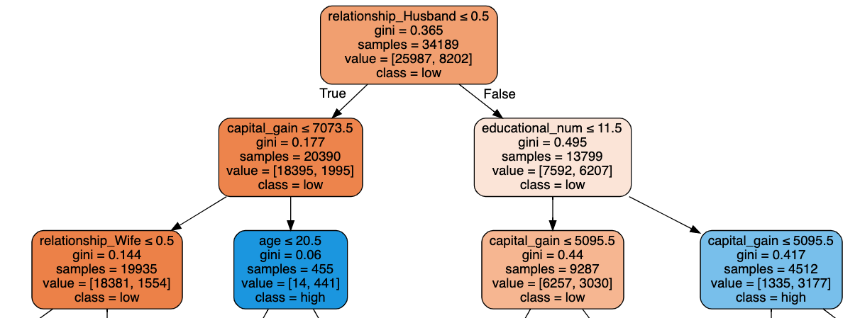
Feature Importance

Slide 8
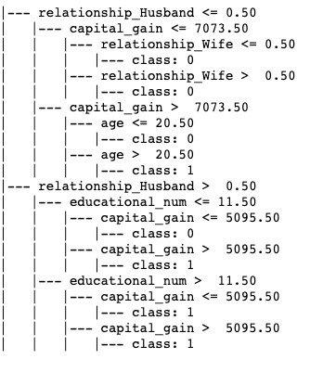
Feature Importance

